Slide 1

Mzkit User Manual
BioNovoGene m/z Data Toolkit User Manual
BioNovoGene Bio-Pharm Technology Co., Ltd
Present: BioDeep R&D Department
E-Mail: R&D@biodeep.cloud
January, 2021, SuZhou, China

Slide 2
Introduction
The main function of Mzkit includes:
Raw Data Viewer
Metabolite Feature Annotation
Molecular Networking
MS-Imaging
Targeted Quantification
Open Source M/z Raw Data File Format Supports:
mzML, mzXML, imzML, mzPack, netCDF, HDF, Mgf

Slide 3
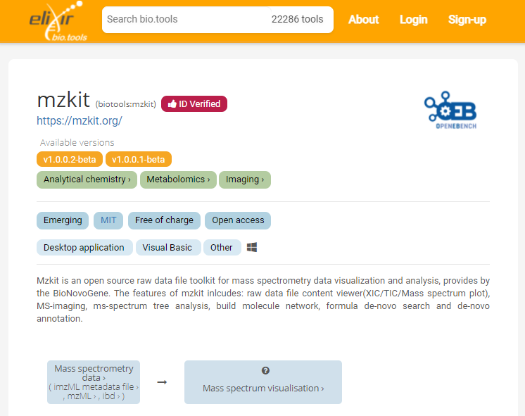
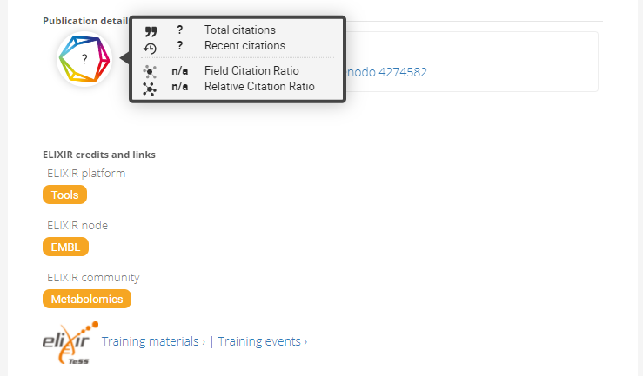
DOI Reference
Mzkit on ELIXIR platform:
https://bio.tools/mzkit
DOI: 10.5281/zenodo.4274582

Slide 4

LICENSE
Mzkit application and its source code is distributed under the MIT open source license
Source Code:
https://github.com/xieguigang/mzkit
Downloads:
http://www.biodeep.cn/downloads?lang=en-US
This document is distributed under Creative Commons Attribution-ShareAlike 4.0 International Public License

Slide 5

Special Thanks
Special thanks to the technical supports from Thermo Fisher Scientific in the development of Mzkit application.
Microsoft .NET library for access Thermo Raw via Microsoft VisualBasic.NET programming.
RawFileReader reading tool. Copyright © 2021 by Thermo Fisher Scientific, Inc. All rights reserved.
https://planetorbitrap.com/

Slide 6
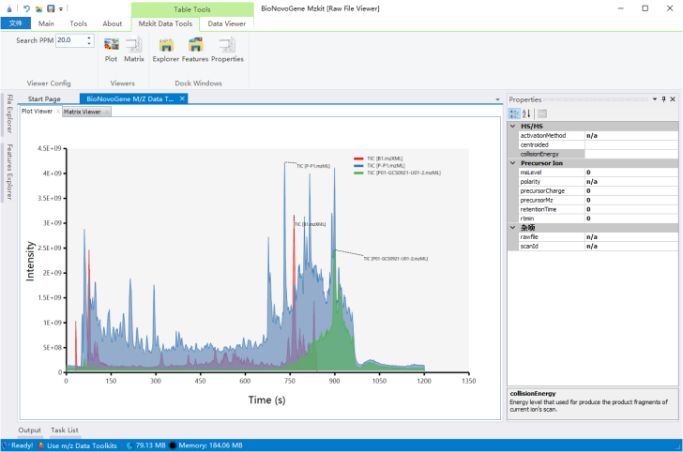
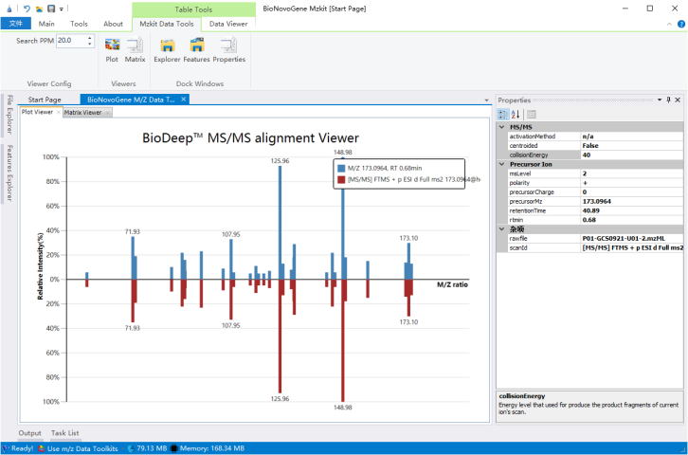
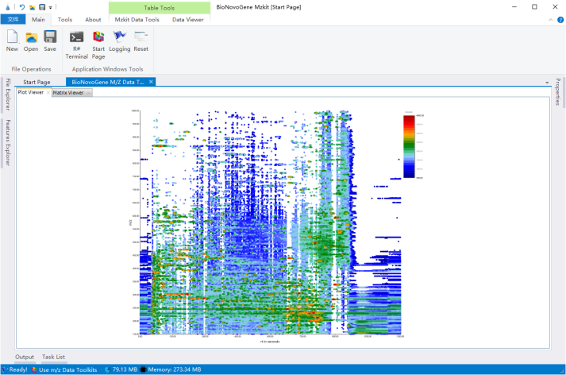
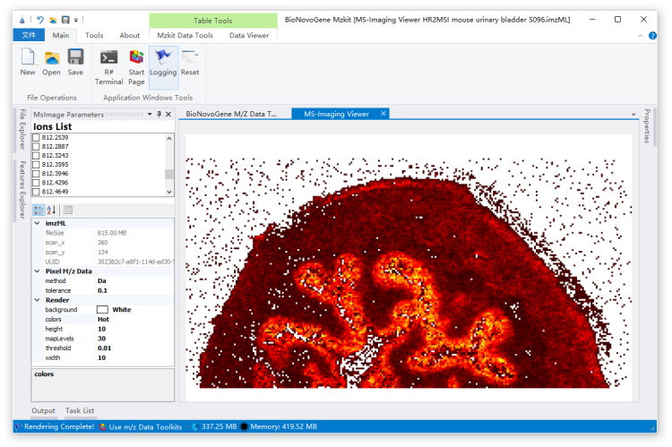
Screenshots
a. Chromatography
b. Spectrum
c. 2D Scatter
d. MS-Imaging

Slide 7
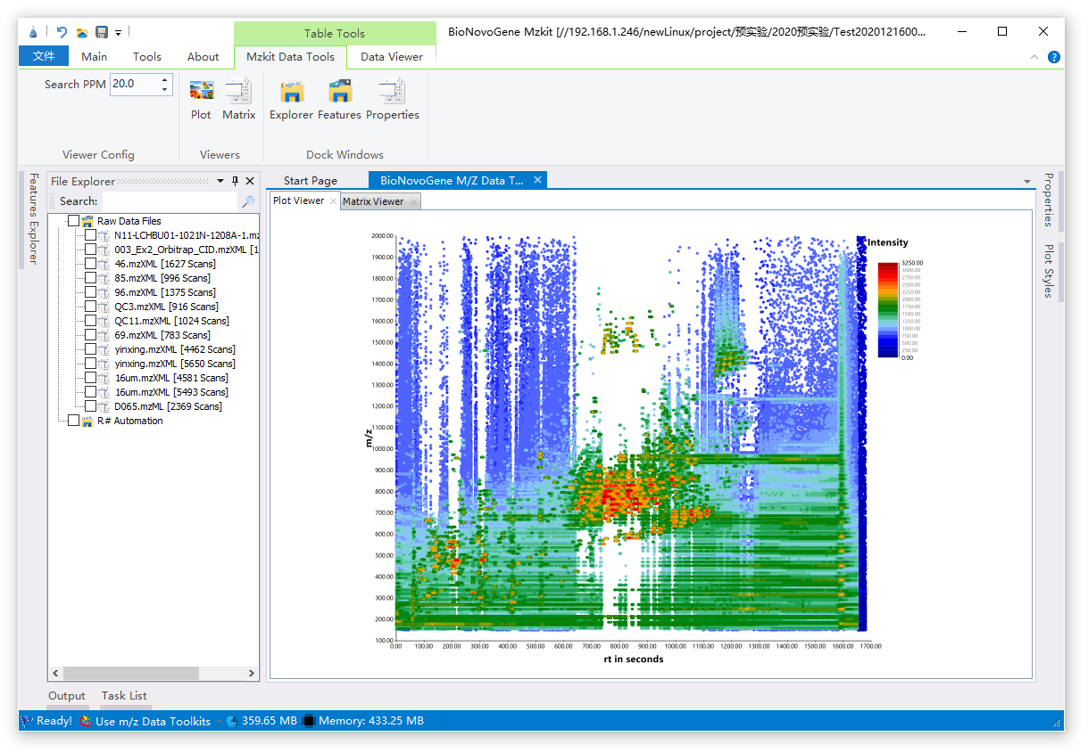
Main Screen
Toolkit Ribbon
Data Explorer
Content Properties
Content Viewer
Status Toolstrip
The main screen page of Mzkit application.

Slide 8
Raw Data Decode

Slide 9

File Formats
mzXML
mzML
imzML
Open Source Format
CDF
HDF5
mzPack
…
Various Closed Source
Vendor Format
Raw
Wiff
Work in progress

Slide 10
File Formats
File Format | Family | Type | Vendor Supports
mzXML/mzML/mzData/imzML | XML | Open Source | Community
CDF/HDF5 | Parallel DataSet | Open Source | Agilent
MGF/MSP | ASCII | Open Source | Community
mzPack | Binary | Open Source | BioNovoGene
Raw | Binary | Closed Source | Thermo Fisher Scientific
Wiff | Binary | Closed Source | AB Sciex

Slide 11
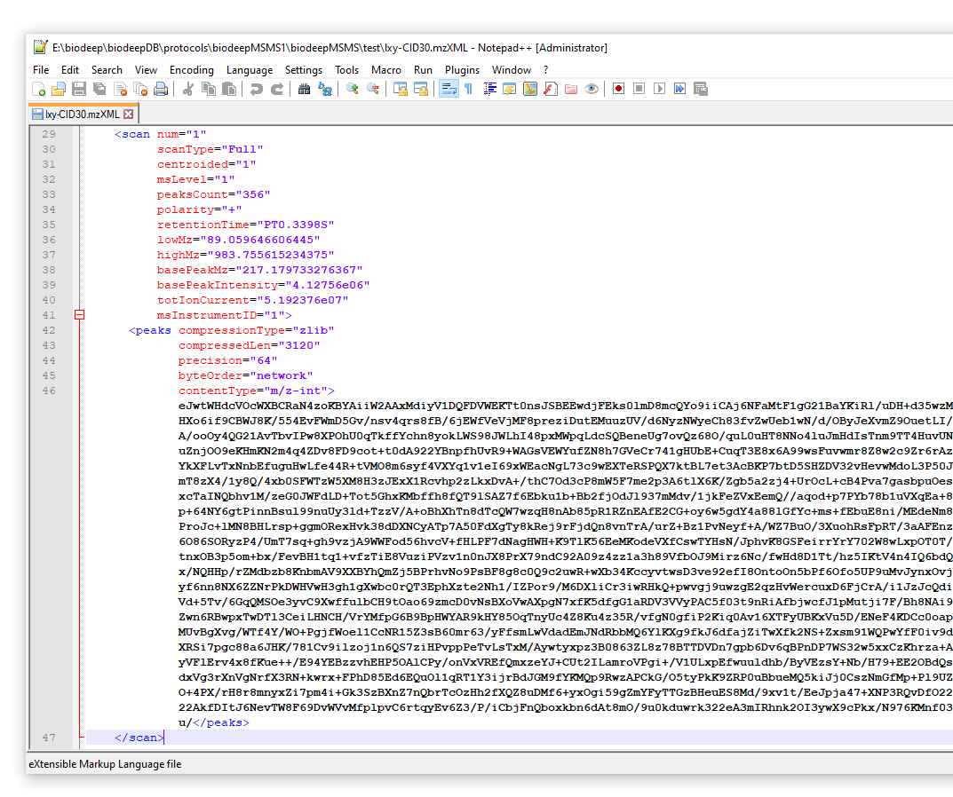
mzXML demo
MS scan meta data
Steps of decode MS scan raw data
base64 decode
decompress based on the compressionType option
BitConvert decode to float or double
create matrix

Slide 12
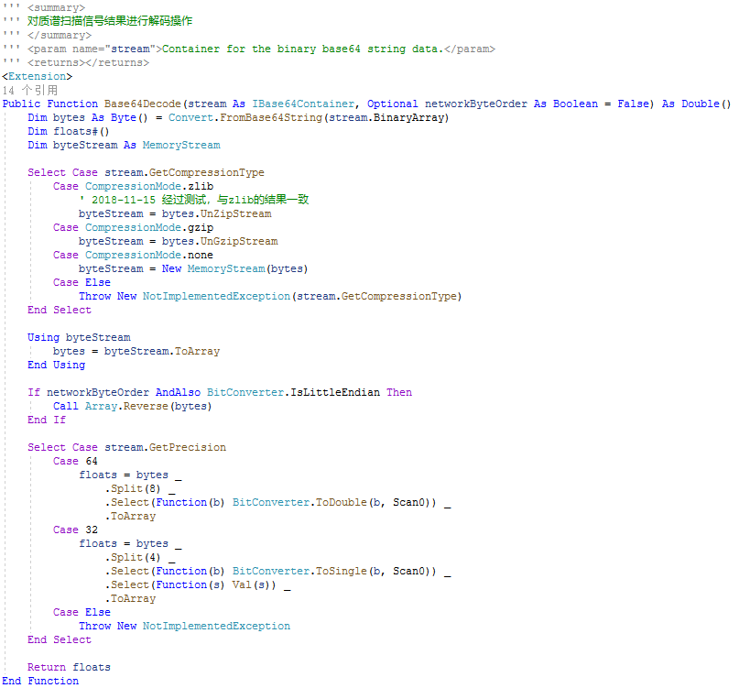
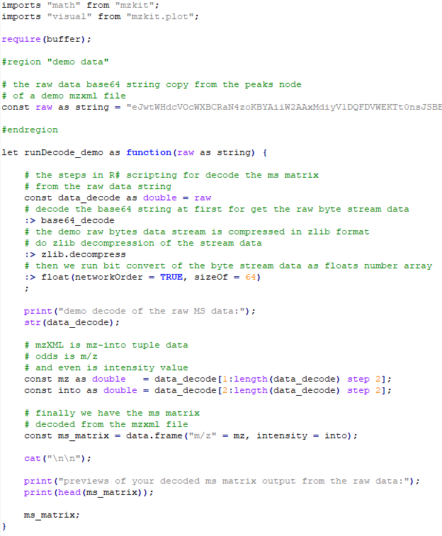
Raw Decode
base64 decode
zlib/gzip decompression
convert to network byteorder
bit convert to floats
Demo code of Base64Decoder for decode mass spectrum
content data in VisualBasic language.
Demo code of decode mass spectrum content data in R#
programming language by using the “buffer” package
module.

Slide 13
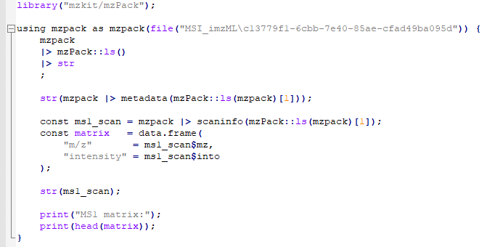
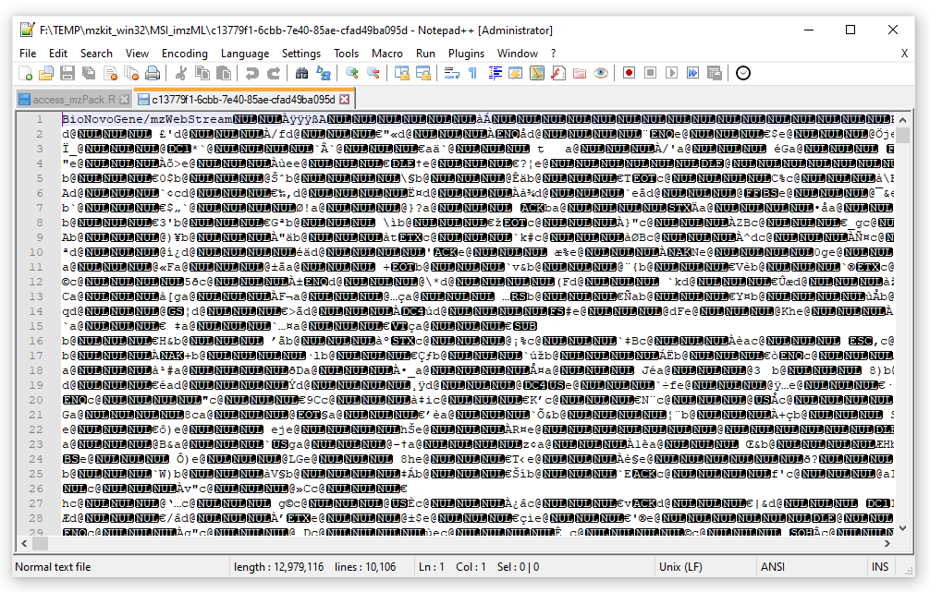
BioNovoGene mzPack
Magic Header: BioNovoGene/mzWebStream
MS data is organized in tree structure in mzPack data file.
Data Sections:
Header Region
MS Scans
Chromatogram Data
Index Region
MetaData

Slide 14
View Untargeted Data
TIC, BPC, EIC
Raw Scatter 2D
XIC Peaks / Contour Plot
PDA
UV Scan

Slide 15
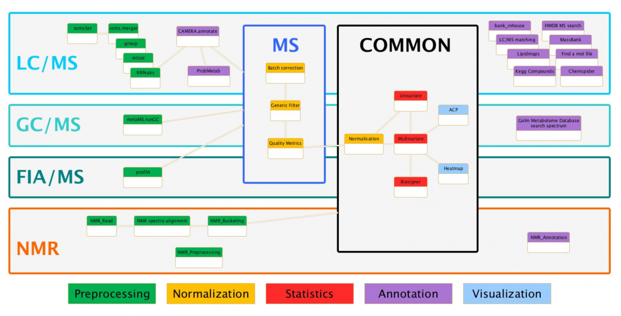
Introduction
Mzkit supports for view data content in common used open source mzXML and mzML file.
Although the raw data file is in various format, but the mass spectrum data in both of them can be unify into the identical data model for downstream visualization or data analysis in Mzkit.

Slide 16
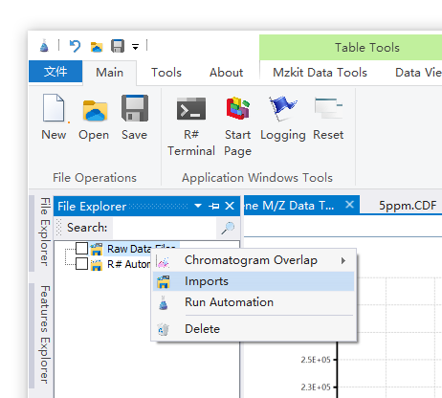
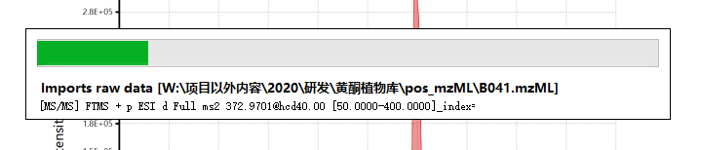
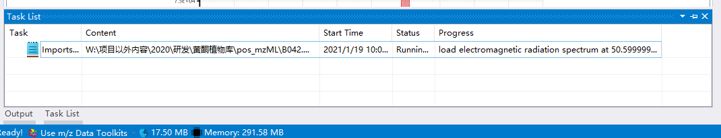
Imports Raw Data
Due to the reason of the data size of untargeted metabolomics raw data file is very large, and reading the raw data in text file is usually slowly. So you should always imports the raw data file into Mzkit at first and then you can view the raw data content in Mzkit.
Open Single File
The file open button accepts many file formats, but only supports one file in one click
Imports Multiple Files
Use the context menu on the file explorer for imports a set of raw data files in batch
A progress bar dialog will appear if this is the first file
that imports into mzkit
The imports progress will be running in background is the first file have been
imported into mzkit. You can view the progress in task list tab.

Slide 17
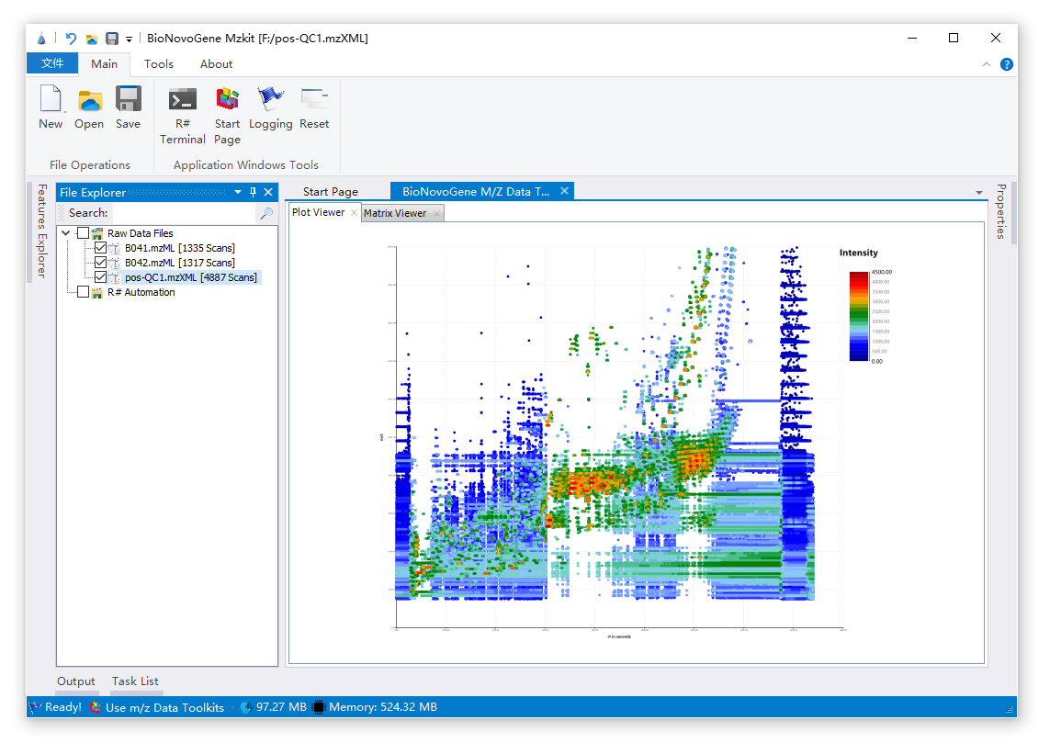
View 2D Scatter Snapshot
The 2D scatter snapshot of a raw data file is consist with m/z and rt these two dimension data plot. And the scatter color is mapping to the ms1 ion intensity. Just click on the file node on the file explorer then you will see the 2D scatter snapshot of your raw data file.
Select File Node
Just click on the file node to view its 2D scatter snapshot

Slide 18
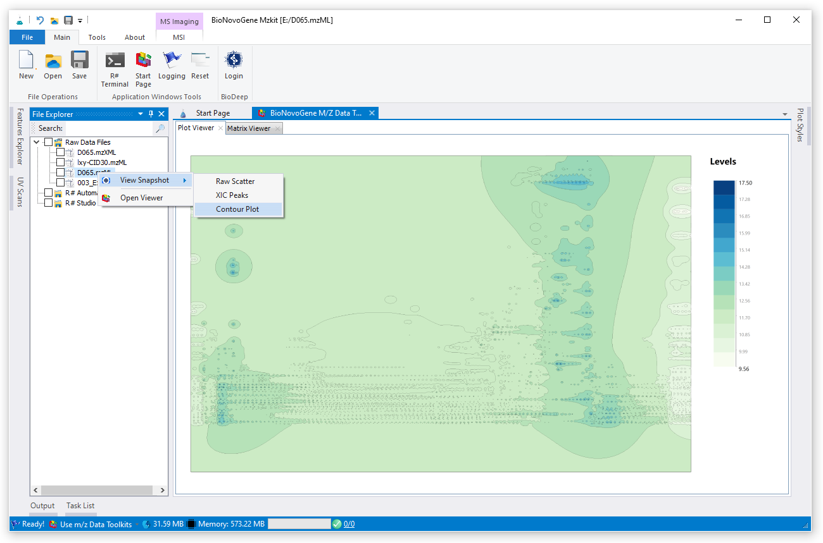
View Contour Snapshot
The contour snapshot of a raw data file is consist with m/z and rt these two dimension data as 2D point. And the contour level is mapping to the ms1 ion intensity. Just click on the file node on the file explorer then you will see the contour scatter snapshot of your raw data file.
Select File Node
Just click on the file node, then select the contour plot on context menu to view its 2D contour snapshot

Slide 19
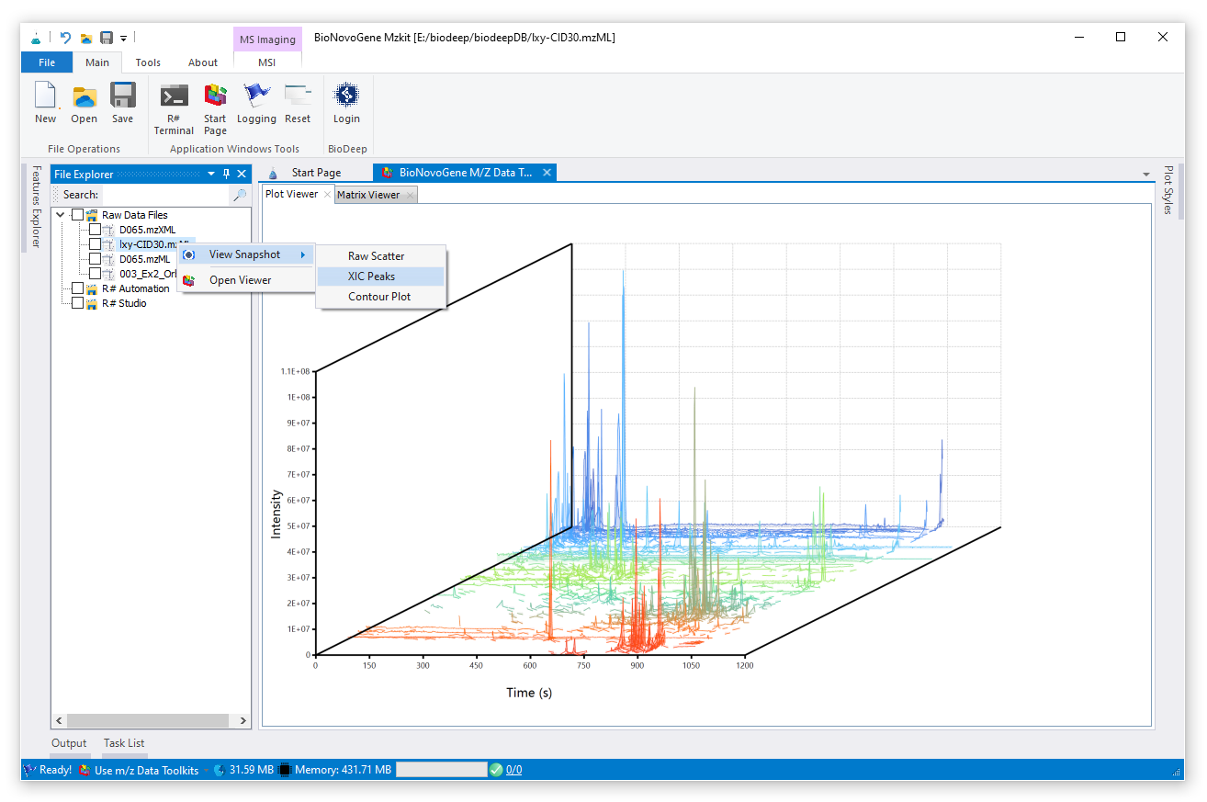
View 3D XIC Snapshot
The 3D XIC snapshot of a raw data file is consist with m/z and rt these two dimension data plot. And the intensity value is mapping to the height of the ions XIC peak. Just click on the file node on the file explorer then you will see the 3D XIC snapshot of your raw data file.
Select File Node
Just click on the file node, then select the XIC peaks on context menu to view its 2D scatter snapshot

Slide 20
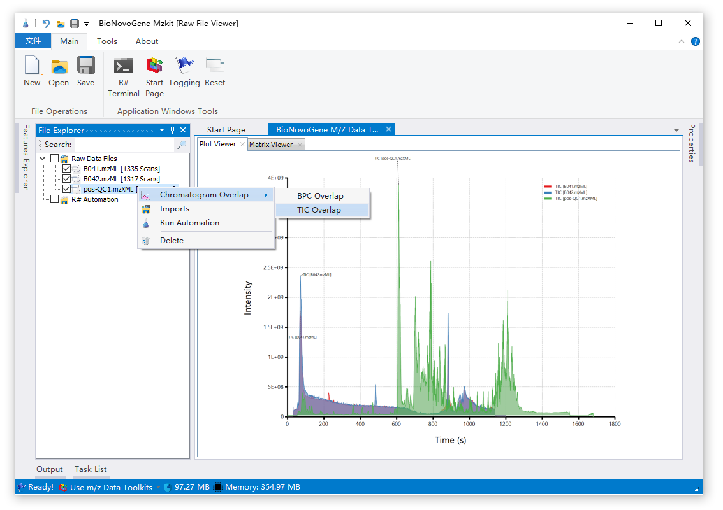
View TIC/BPC
Both the TIC and BPC plot is a kind of time-signal plot but with different meanings.
TIC is the chromatography plot of total ions.
BPC is the Chromatography plot of the max intensity ion.
View Chromatography
View TIC/BPC from the contex menu of the file explorer. If multiple file was selected, then TIC/BPC overlaps will be display

Slide 21
View QC Overlay
We generally view of the QC files’ TIC/BPC overlay, as the QC is theoretically the result of the system error of the LCMS experiment. The more consistent the TIC/BPC overlay, the better the data quality of the current batch of LCMS experiments it is:
By looking at the QC overlay, you can get the most intuitive picture of the data quality from current experiment batch;
By looking at the overlays between different batches, we can see how Severity the original data is shifted in RT between experiments in several batches intuitively.

Slide 22
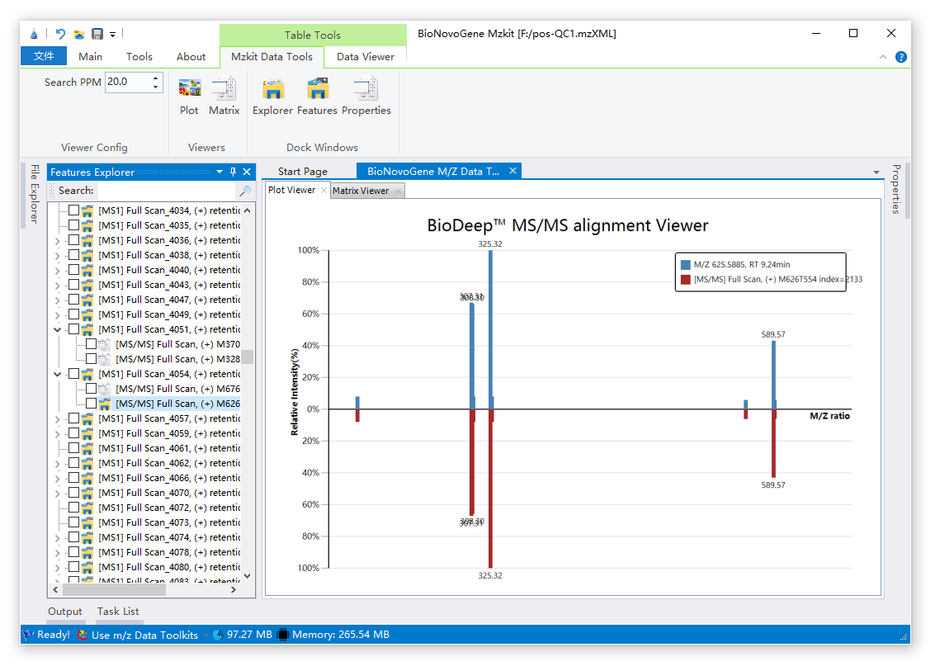
View Scan Feature
The raw data is consists with multiple spectrum scans in MS1 or MS2 levels
The scan in a raw data file is organized in a tree liked data: A parent MS1 scan contains multiple product ion scans.
View Mass Spectrum
Click one of the scan node in the Feature explorer for view its mass spectrum data.

Slide 23
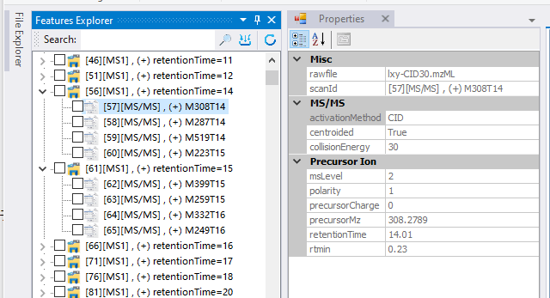
Scan Tree In MS
MS_raw
|__MS1
| |__ MS2
| |__ MS2
| |__ MS2
| |__ MS3
| |__ MS3
|__MS1
...
In our mass spectrometry parent ions in MS1, the mass spectrometer picks out Top n ions, make Ms2 fragmentation.
And based on these MS2 product as parent ions, we can also pick out the top m ion fragments from the secondary ion fragments and continue to produce the next level of MS3 mass spectrometry fragmentation information.

Slide 24
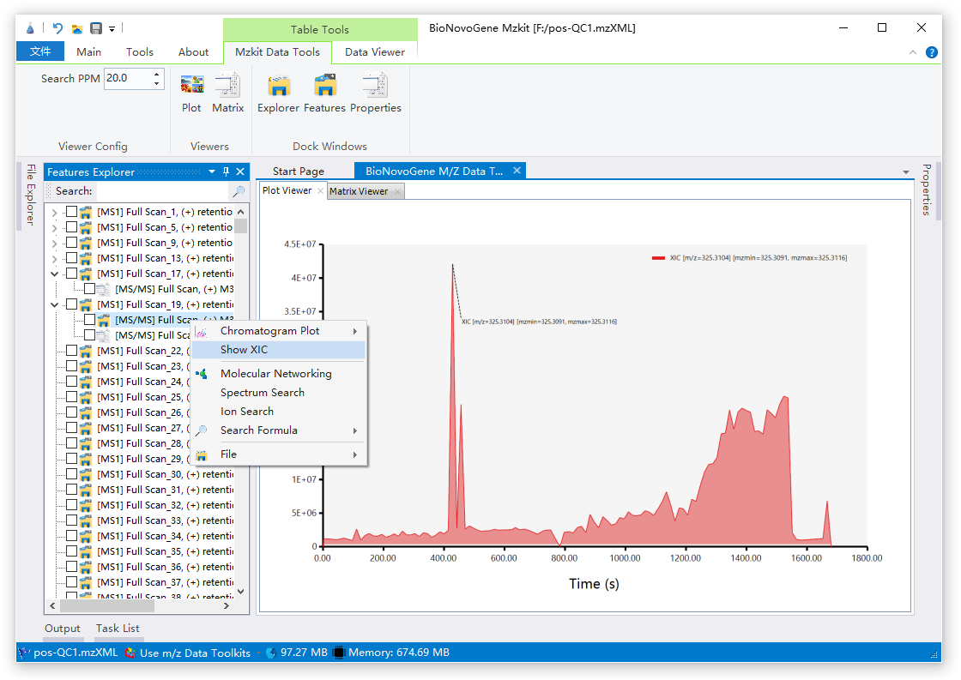
View XIC
XIC plot is a kind of time-signal plot which is very similar to TIC or BPC.
XIC comes from a set of specific product ion with their parent intensity correlation to scan times.
View XIC Chromatography
Click one of the Ms2 scan node in the Feature explorer, and then select Show XIC on context menu for view its Chromatography plot

Slide 25
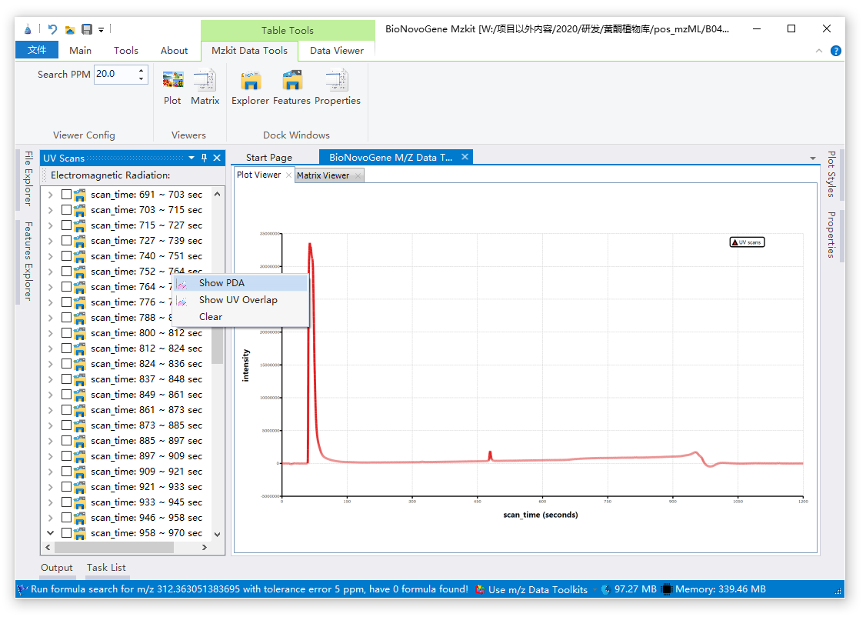
View PDA
PDA plot is a kind of time-signal plot which is very similar to the TIC plot.
Electromagnetic radiation spectrum is supported in mzML file, mzXML file format is not supprted.
Show PDA
Just select the Show PDA menu item on the context menu in the UV scans explorer

Slide 26
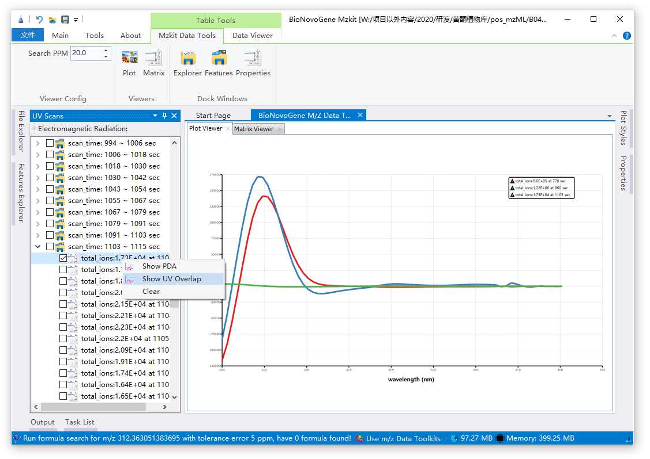
View UV scans
Electromagnetic radiation spectrum is supported in mzML file, mzXML file format is not supprted.
Show UV Overlap
Just select the Show UV Overlap menu item on the context menu in the UV scans explorer. If multiple scan was selected, then UV scan overlap will be plot

Slide 27
DIA Annotation

Slide 28
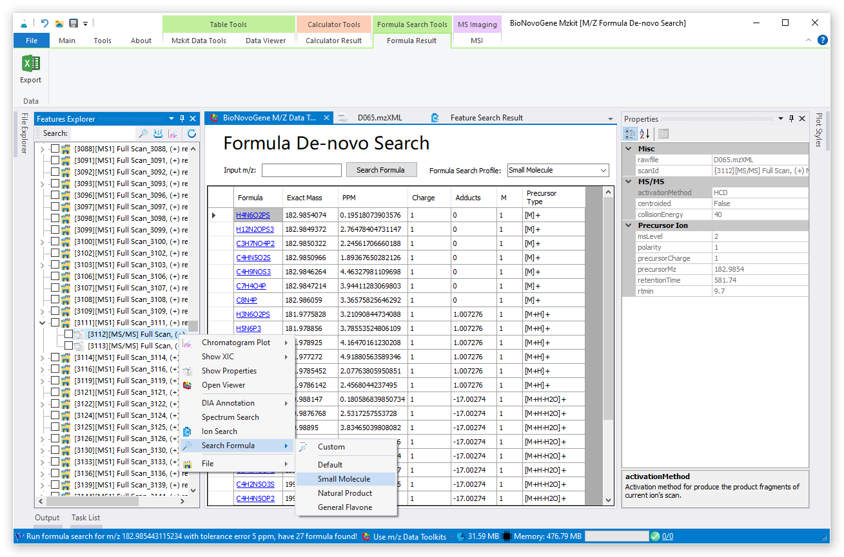
Formula Search
Formula Link
Click on the link of one formula for query in BioDeep knowledge database
Formula Search
Select one of MS2 ion feature for run formula search
View Search Result
Formula search result includes formula, exact mass, ppm error between the m/z and the evaluate m/z, precursor info

Slide 29
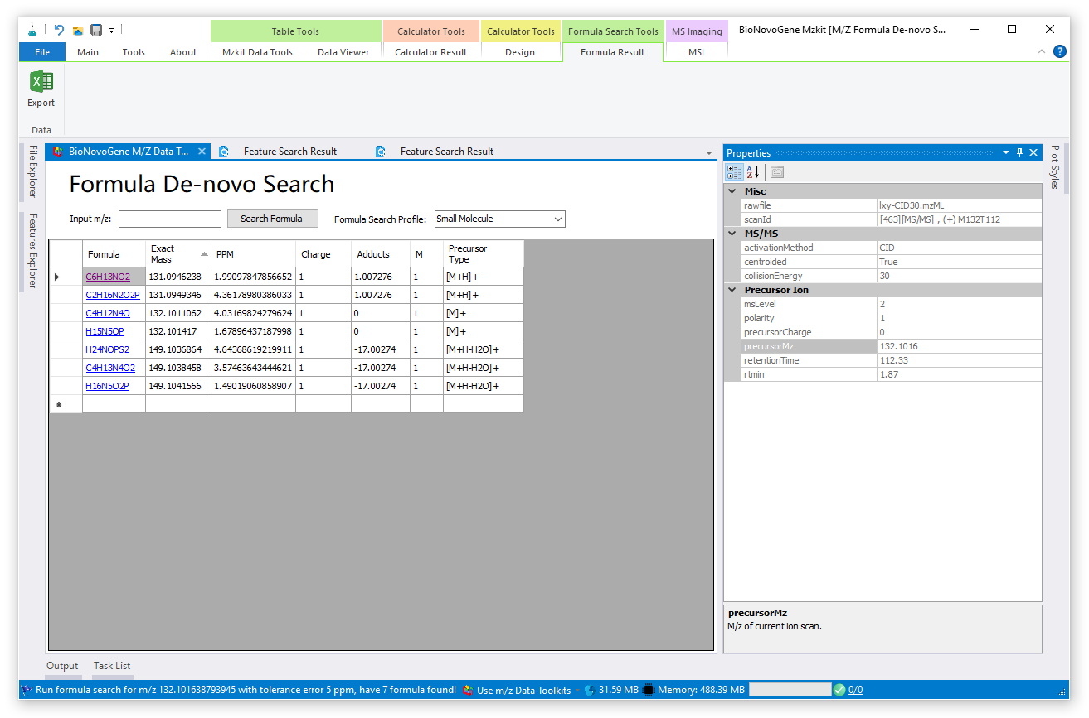
DEMO Search
One Ms2 ion feature with m/z 132.1016 and rt at 112 sec was selected for run formula de-novo search.
A list of candidate formula was generated, with different exact mass and precursor type for match the parent ion m/z 132.1016

Slide 30
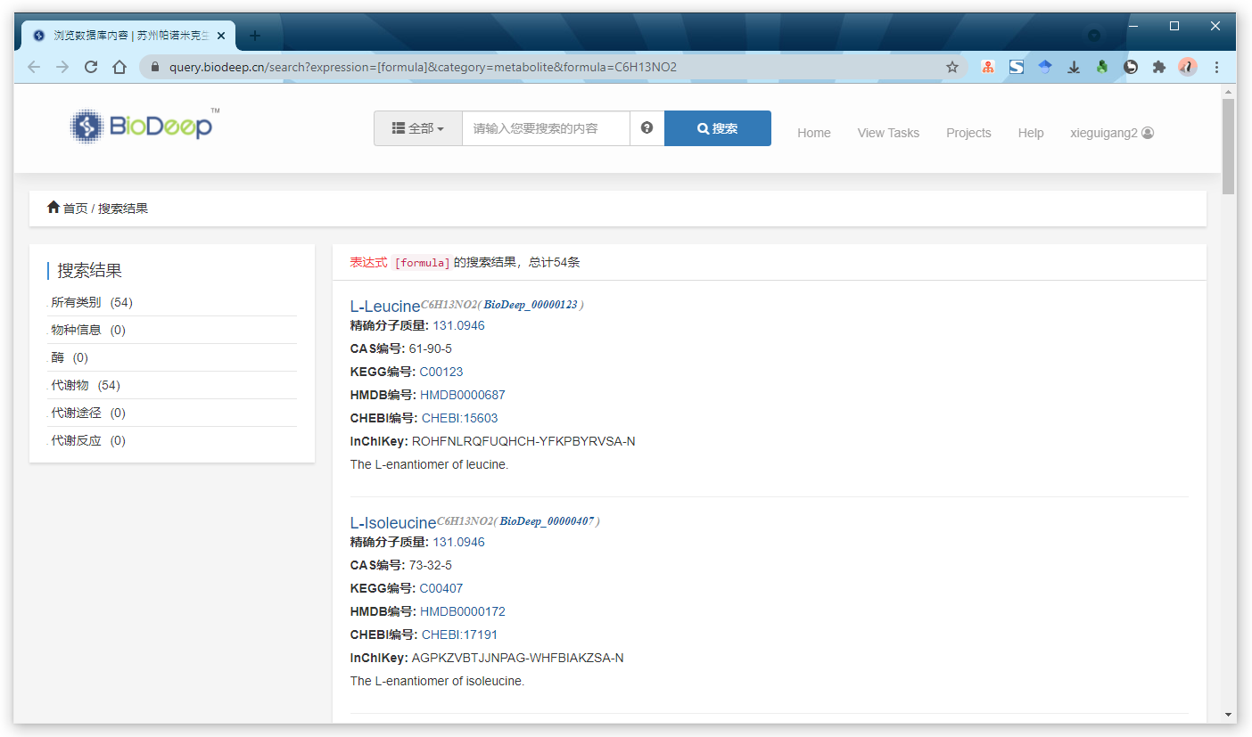
Query BioDeep
Click of the formula link for query BioDeep KB with formula as search term
Find Leucine match the formula search result:
C6H13NO2[M+H]+

Slide 31
DIA Annotation (MetaDNA)

Slide 32
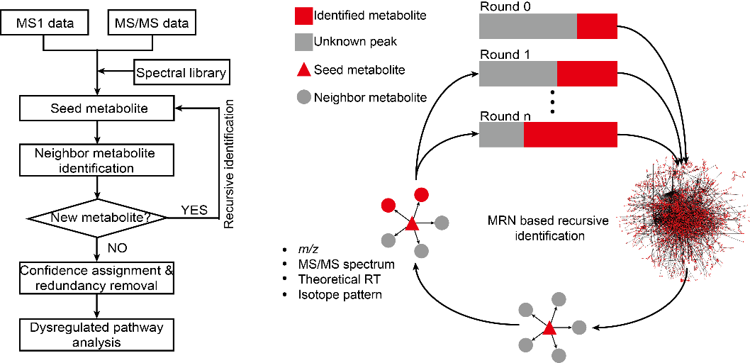
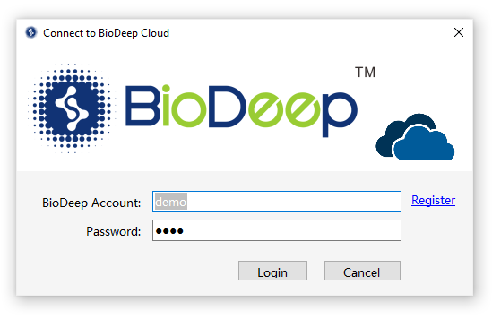
MetaDNA
Metabolic reaction network and spectral similarity of neighbor metabolites in reaction pairs.
The construction of MRN using the reaction pairs retrieved from KEGG. An example is given to show that structurally similar reaction-paired neighbor metabolites have a high similarity of MS2 spectra. b Spectral similarity between metabolites in reaction and non-reaction pairs, respectively.
The neighbor metabolites are then annotated by using the matching m/z, surrogate MS2 spectrum, and theoretical RT with unknown peaks (gray square, round 1). The recursive annotation runs until there are no new annotated metabolites (round n).
Apply MetaDNA DIA annotation in mzkit software required of Connect to BioDeep Cloud Services
X. Shen, R. Wang, X. Xiong, Y. Yin, Y. Cai, Z. Ma, N. Liu, and Z.-J. Zhu* (Corresponding Author),
Metabolic Reaction Network-based Recursive Metabolite Annotation for
Untargeted Metabolomics, Nature Communications, 2019, 10: 1516.

Slide 33
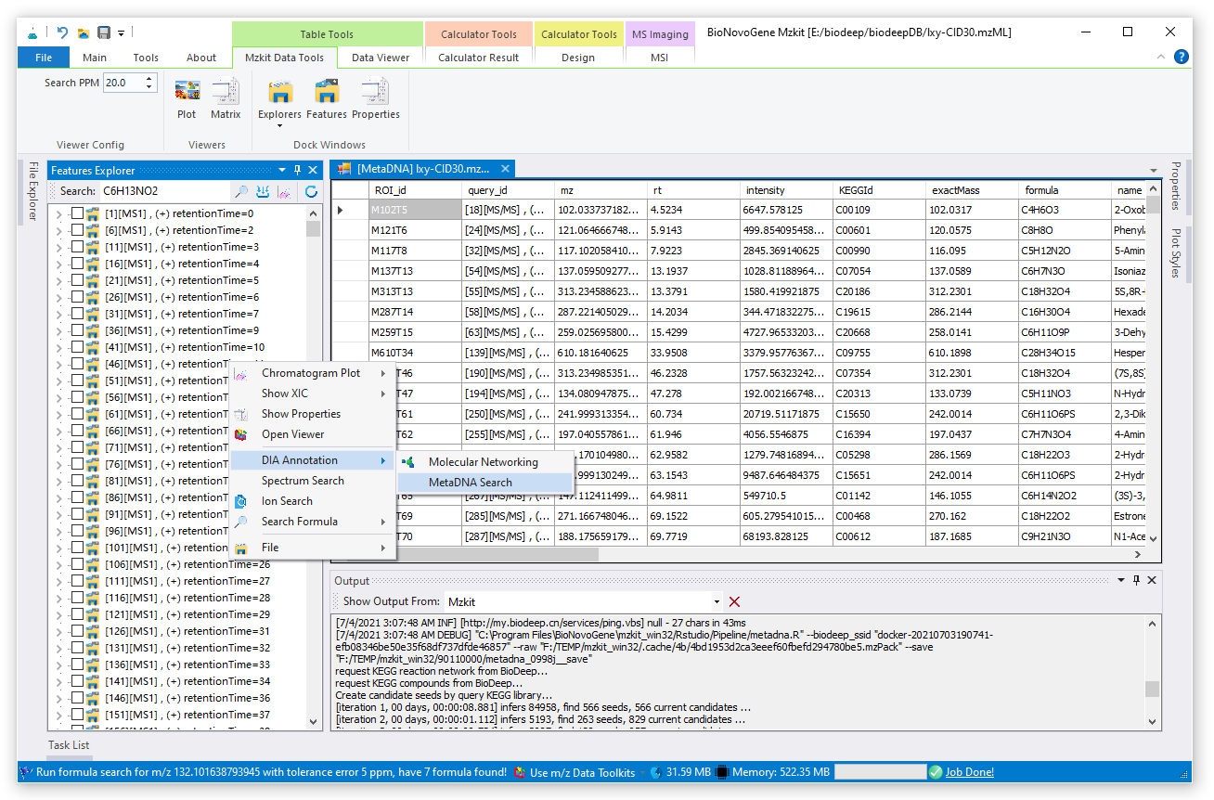
MetaDNA Search
MetaDNA Result Table
Show the MetaDNA DIA annotation result at here, include KEGG ID, KEGG reaction chain information, KEGG partner compound information
MetaDNA Search
Run metaDNA search via context menu on the raw data file features explorer

Slide 34
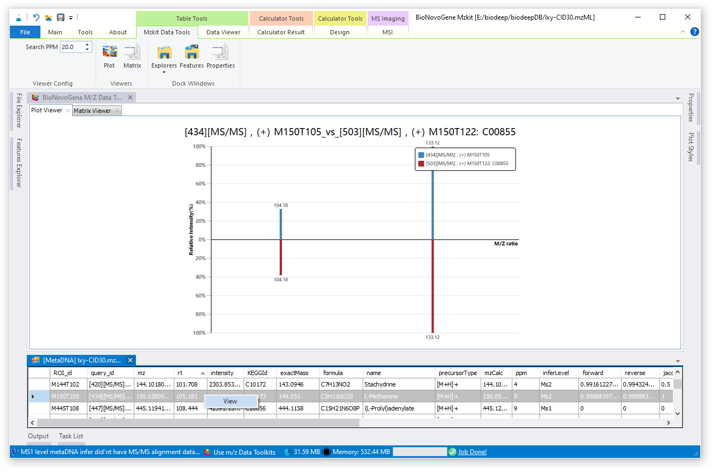
View MetaDNA Infer Alignment
MetaDNA Alignment
The MS2 DIA alignment from metaDNA result will be show at the plot viewer
The L-Methionine its predicted as 104.18/133.12 in MS2
View MetaDNA Alignment
Select one row in the result table, and then show contex menu with mouse right button click

Slide 35
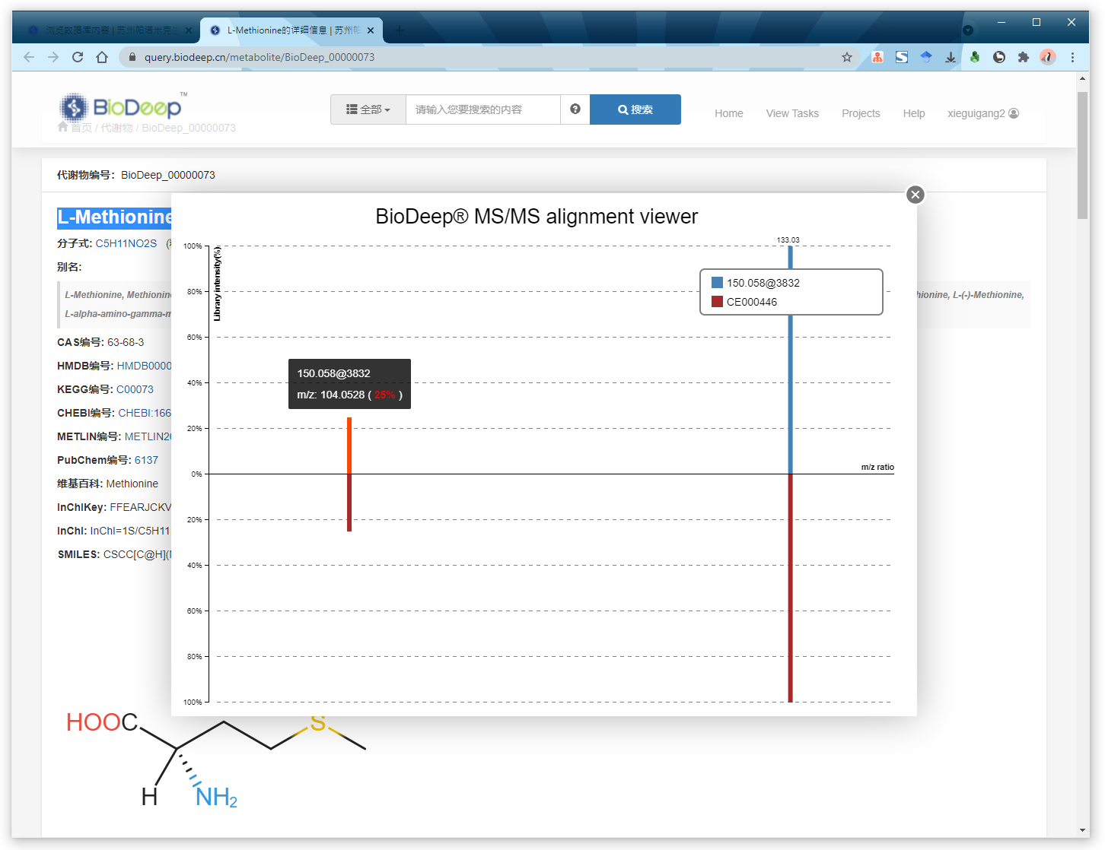
BioDeep MS Reference(MoNA)
One of the MS reference data record(MoNA: CE000446) in BioDeep database shows that the MS2 of L-Methionine is [104.0528, 133.03]
The metaDNA DIA annotation MS2 is [104.18, 133.12], metaDNA DIA annotation is agree with the MS reference data record.
ROI feature M150T105 is annotated as L-Methionine successfully via metaDNA DIA annotation in mzkit software.

Slide 36
Chromatography Explorer

Slide 37
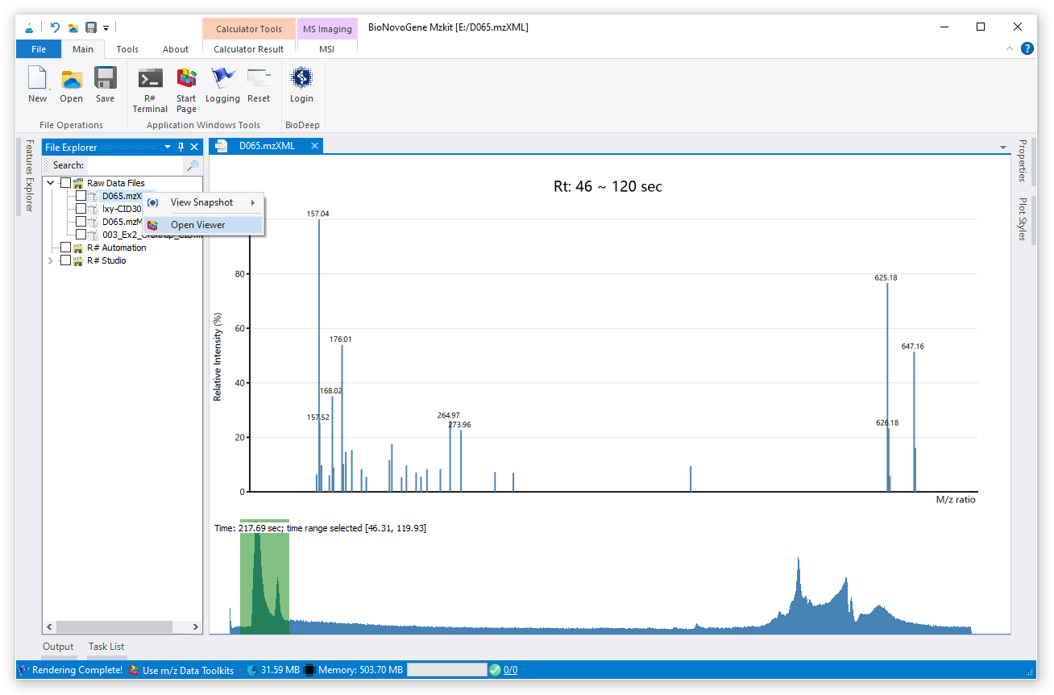
Chromatography Explorer
Open Explorer
Select one of the raw data file in the file explorer and then open viewer from the context menu.
Select RT range
View all MS1 ions in the given range of MS1 scans by rtmin and rtmax.
View MS1
Display MS1 ions in a given rt range.

Slide 38
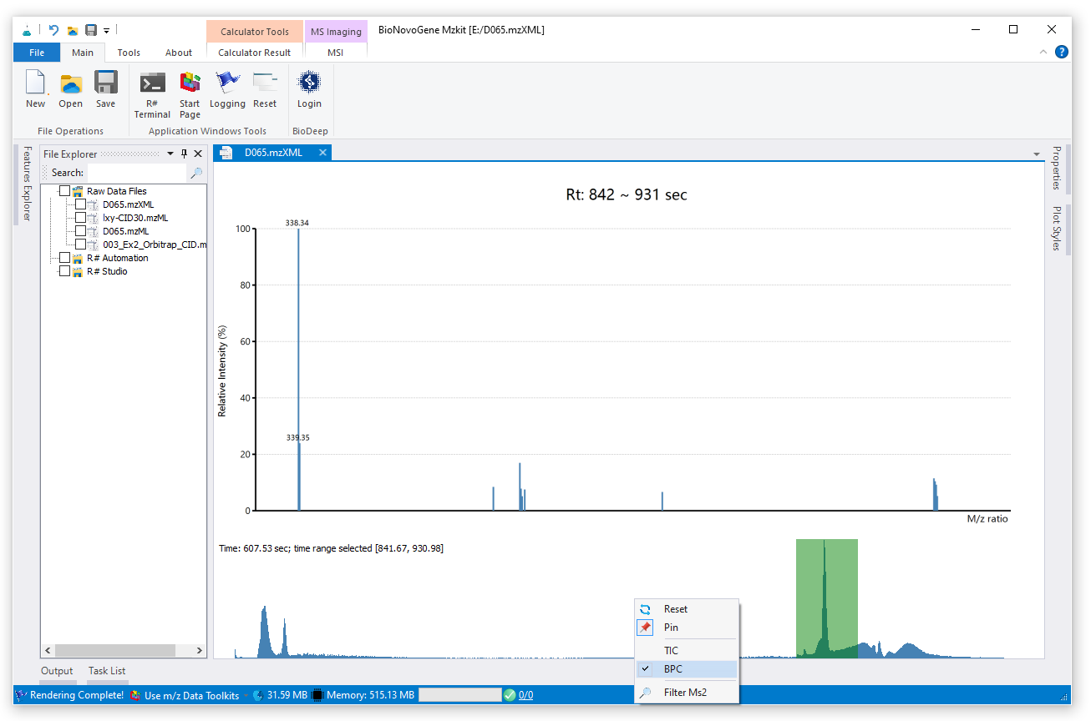
Explorer Contex Menu
Reset: for reset explorer to initial status
Pin: mouse select of the RT range will not update explorer to new RT range
TIC/BPC: switch the Chromatography between the TIC and BPC
Filter MS2: Show the ms2 ions in the given RT selection range

Slide 39
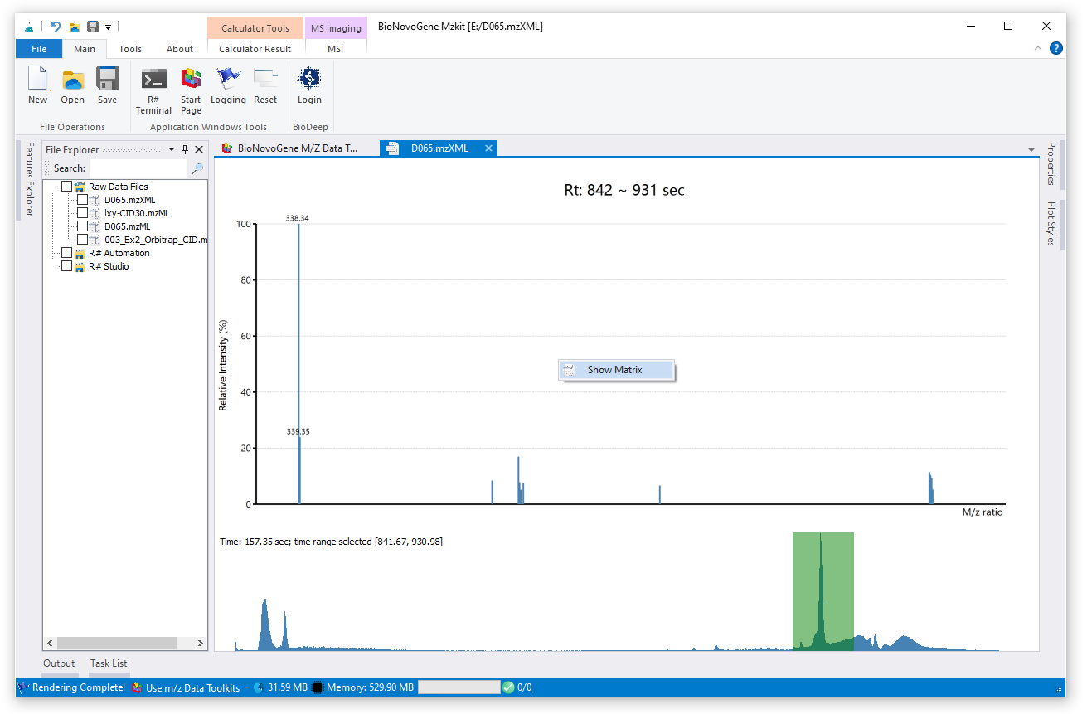
View MS1 Ions
Show Matrix
View all MS1 ions in the given range of MS1 scans by rtmin and rtmax.

Slide 40
MS-Alignment

Slide 41
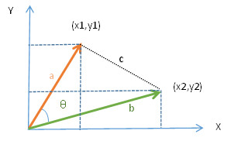
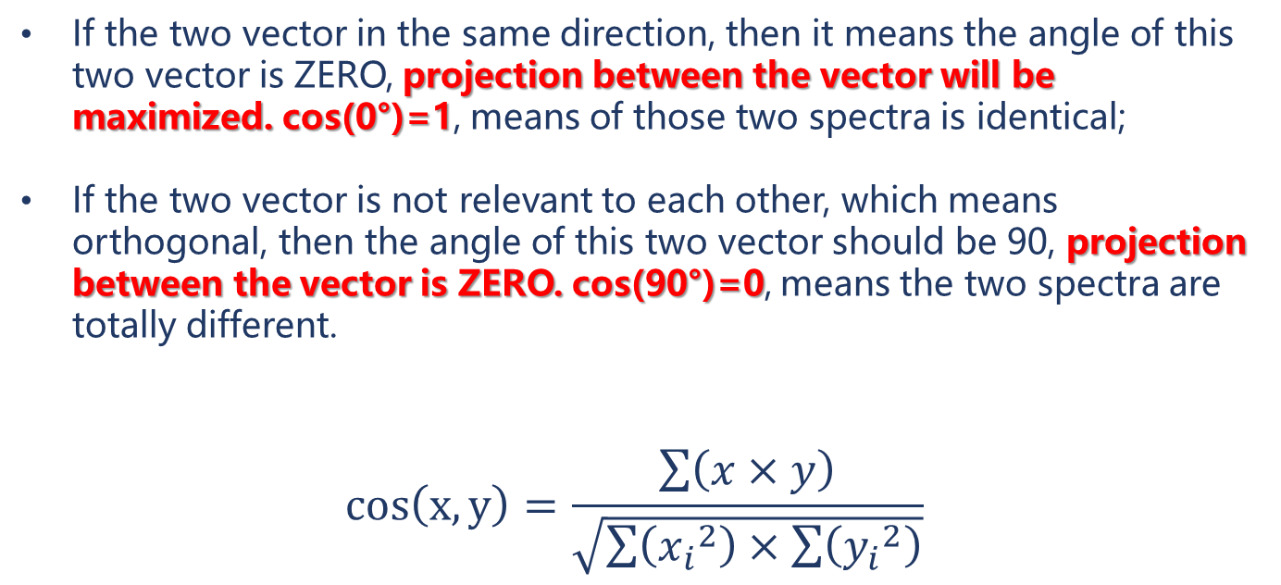
Cos Similarity
If the two vector in the same direction, then it means the angle of this two vector is ZERO, projection between the vector will be maximized. cos(0°)=1, means of those two spectra is identical;
If the two vector is not relevant to each other, which means orthogonal, then the angle of this two vector should be 90, projection between the vector is ZERO. cos(90°)=0, means the two spectra are totally different.
$$cos\left(x,y\right)=\frac{\sum{\left(x×y\right)}}{\sqrt{\sum{\left({x_{i}}^{2}\right)×\sum{\left({y_{i}}^{2}\right)}}}}$$
vector x, y could be in different value scale range.

Slide 42
MS-Alignment
query
Forward: using query as base matrix
m/z | intensity
100 | 100
200 | 50
300 | 80
350 | 80
m/z | 100 | 200 | 300 | 350
query | 100 | 50 | 80 | 80
reference | 100 | 0 | 60 | 0
$$\cos\left(\begin{matrix}query & reference\end{matrix}\right)=0.7978698$$
Reverse: using reference as base matrix
reference
m/z | 100 | 300 | 310
query | 100 | 80 | 0
reference | 100 | 60 | 10
m/z | intensity
100 | 100
300 | 60
310 | 10
$$\cos\left(\begin{matrix}reference & query\end{matrix}\right)=0.987369$$
Cos similarity result i$s min\left(forward, reverse\right)=0.7978698$, this two spectra is not so similar

Slide 43
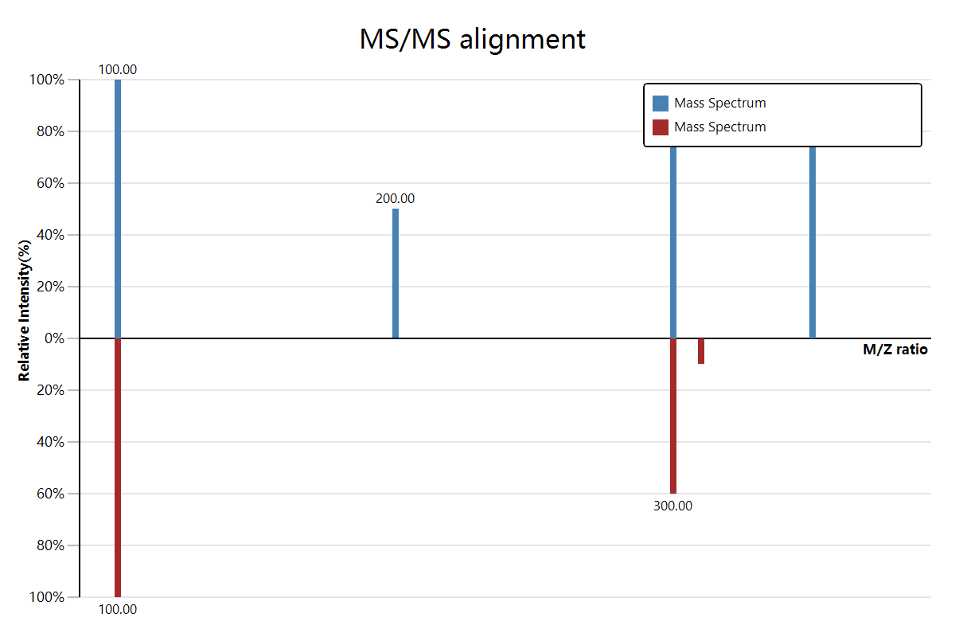
MS-Alignment
Cos similarity result i$s min\left(forward, reverse\right)=0.7978698$, this two spectra is not so similar

Slide 44
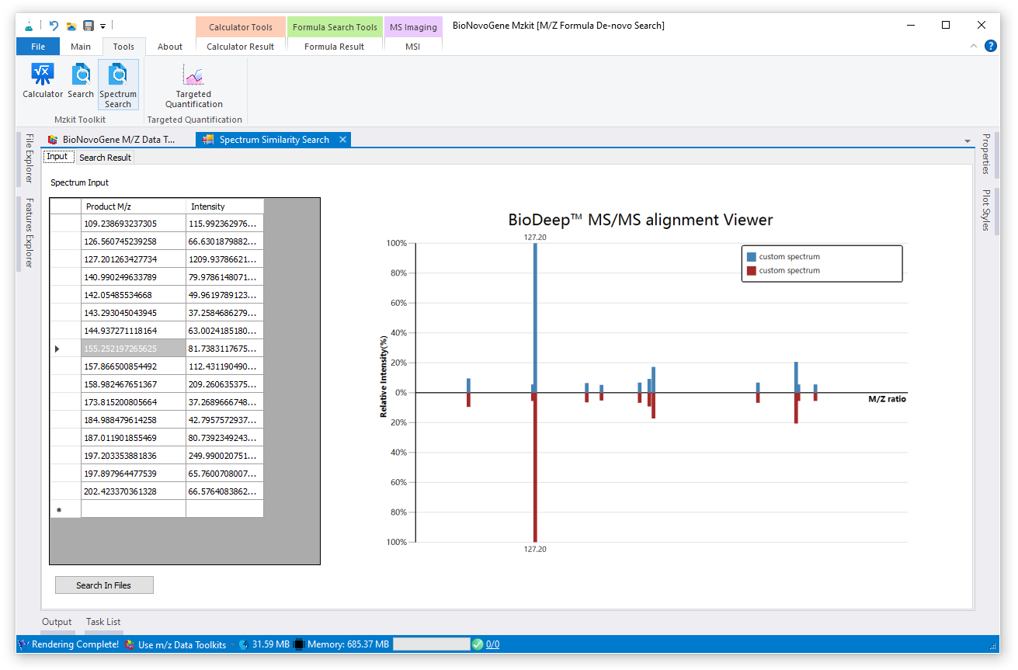
MS2 Search
Spectrum Search
Click Spectrum Search Icon for open MS2 search toolkit
Input Spectrum
Input MS2 spectrum matrix at the input table
Run Search
Click Search button for run MS2 search between all raw data files in the file explorer

Slide 45
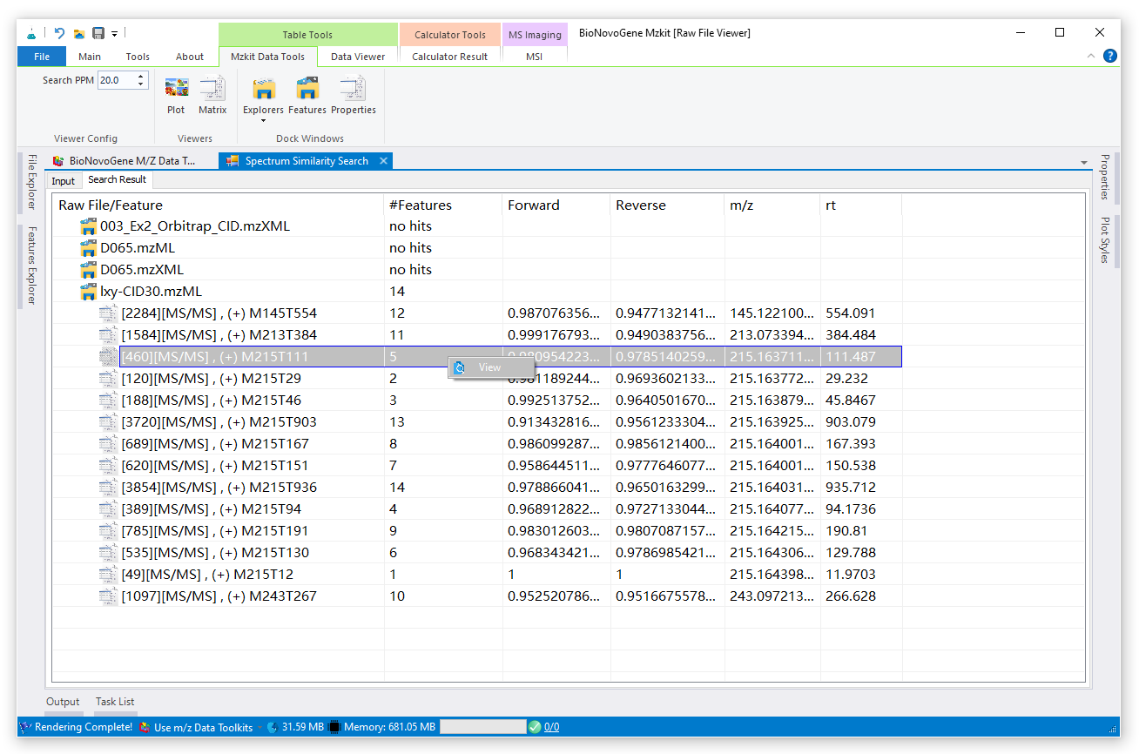
View MS2 Search Result
Search Result
All of the ms2 will be align with the custom MS matrix. No hits means no similar MS matrix in raw data file.
View MS alignment
Mouse click with right button will pop up a context menu for view MS2 alignment result

Slide 46
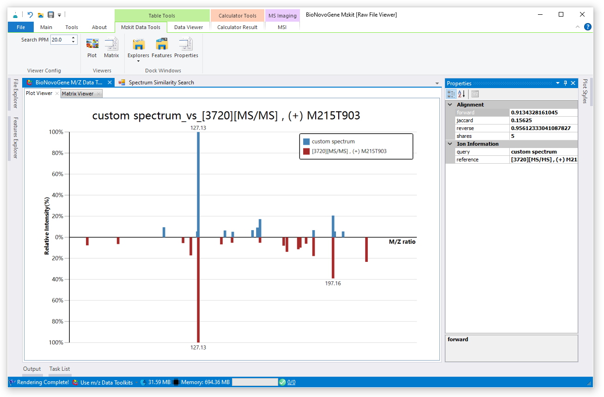
View MS2 Alignment
MS2 Alignment
View the ms2 alignment result between the custom MS spectrum input and target ions in raw data file
Alignment Score
View the alignment score details

Slide 47
MS-Imaging Viewer

Slide 48
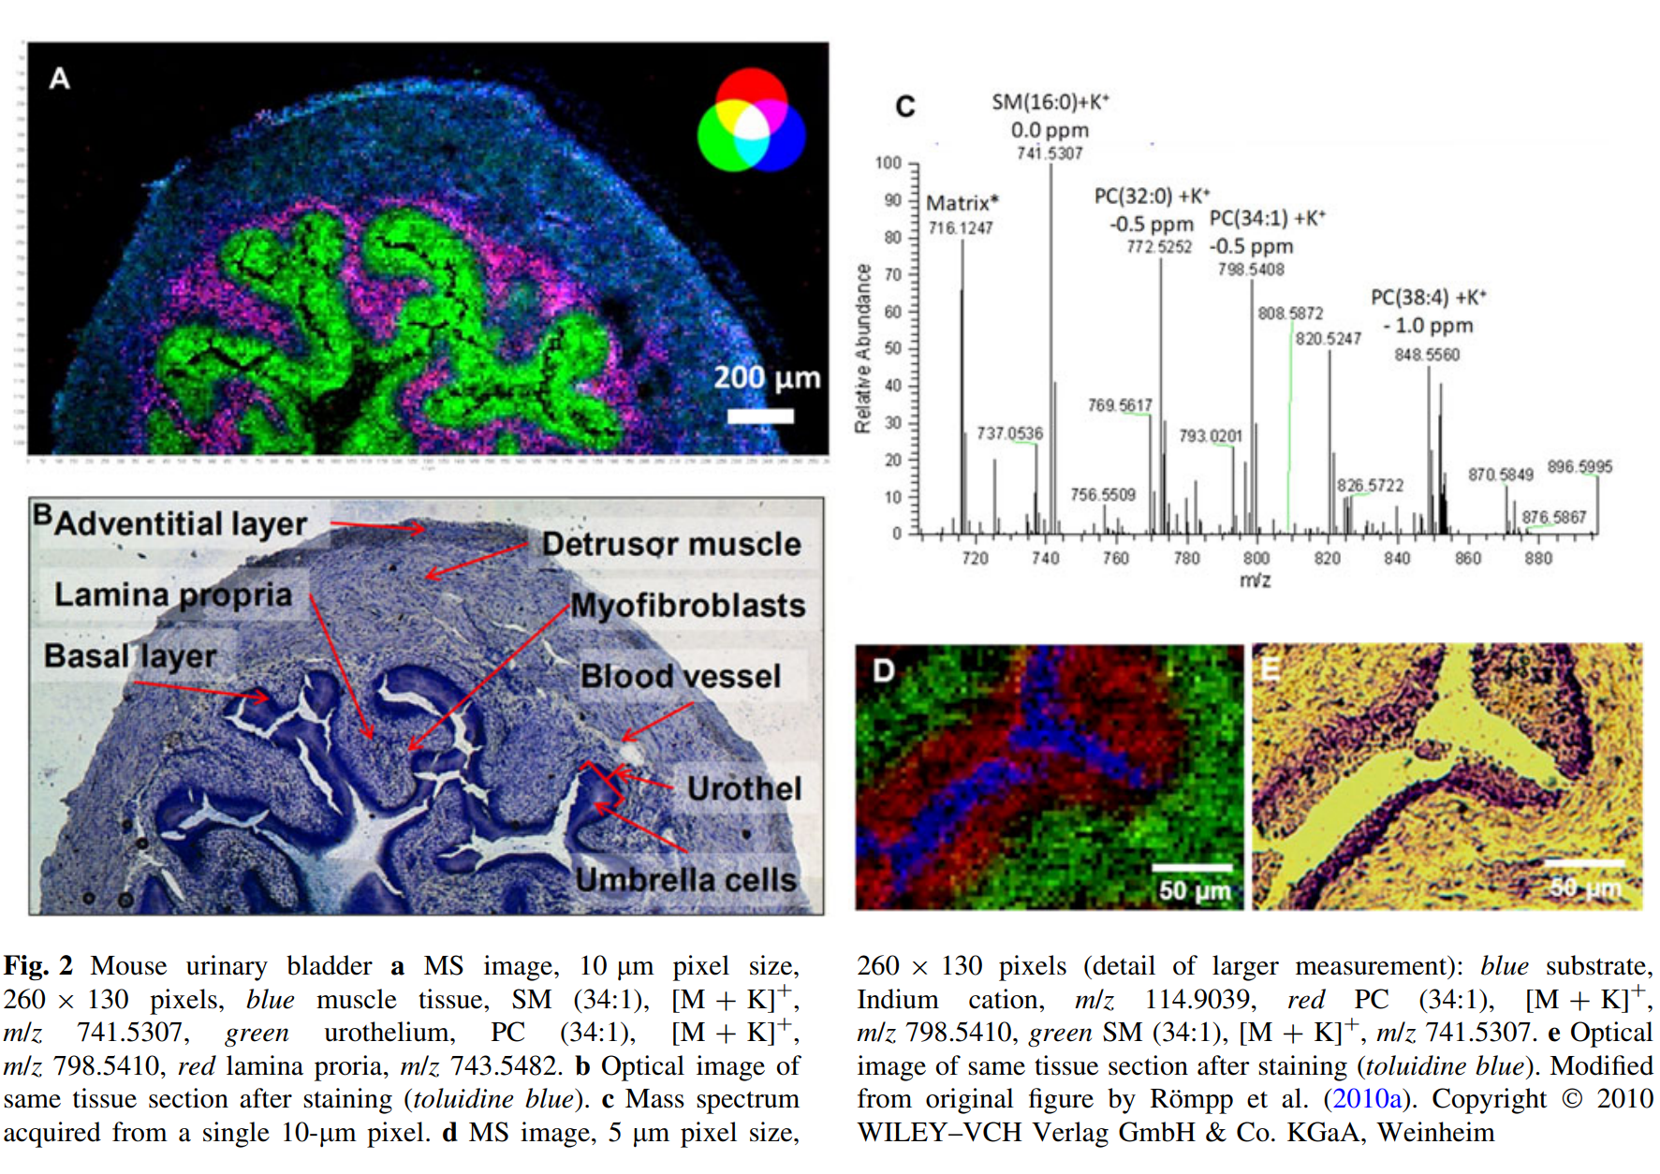
Introduce MS-Imaging
Mass spectrometry imaging (MSI) is a technique used in mass spectrometry to visualize the spatial distribution of molecules, as biomarkers, metabolites, peptides or proteins by their molecular masses. By choosing a peak in the resulting spectra that corresponds to the compound of interest, the MS data is used to map its distribution across the sample. This results in pictures of the spatially resolved distribution of a compound pixel by pixel.
Römpp A, Spengler B. Mass spectrometry imaging with high resolution in mass and space.
Histochemistry and Cell Biology. 2013 Jun;139(6):759-783.
DOI: 10.1007/s00418-013-1097-6.

Slide 49
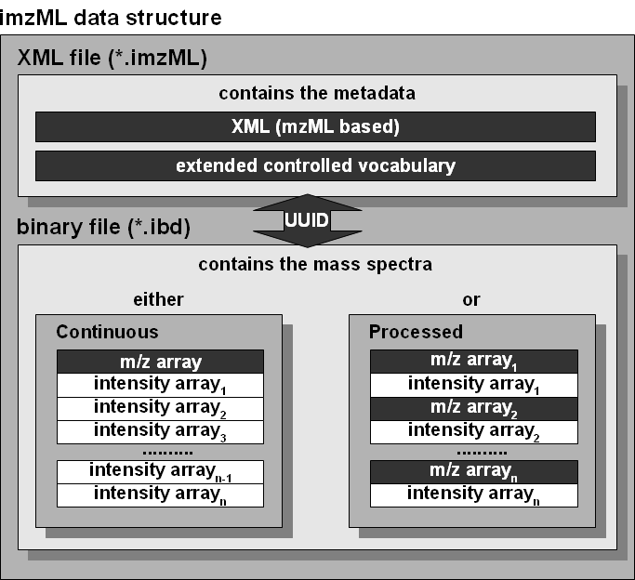
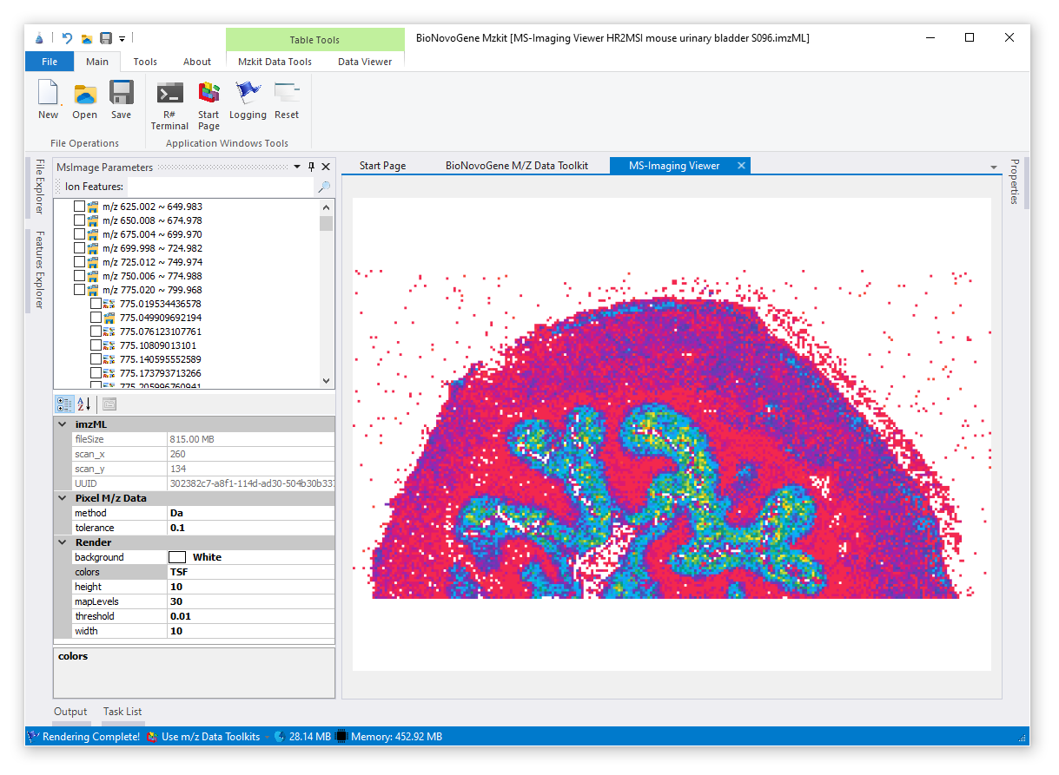
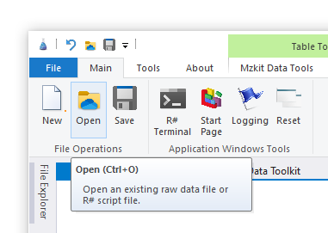
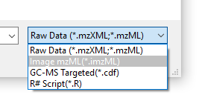
imzML for MS-imaging
Mzkit Supports the imzML file format for view ms-imaging content.
Steps for view MS-imaging
in Mzkit:
[Main] Open
Select imzML format
Select ion for view image

Slide 50
MS-imaging
Ion Explorer
Select one ion or multiple ions at here.
Context menu on mouse right click for run image rendering.
MSI Viewer
View MS-Imaging rendering image output
Render Options
Tweaks of the MS-Imaging rendering options
MS-imaging in Mzkit

Slide 51
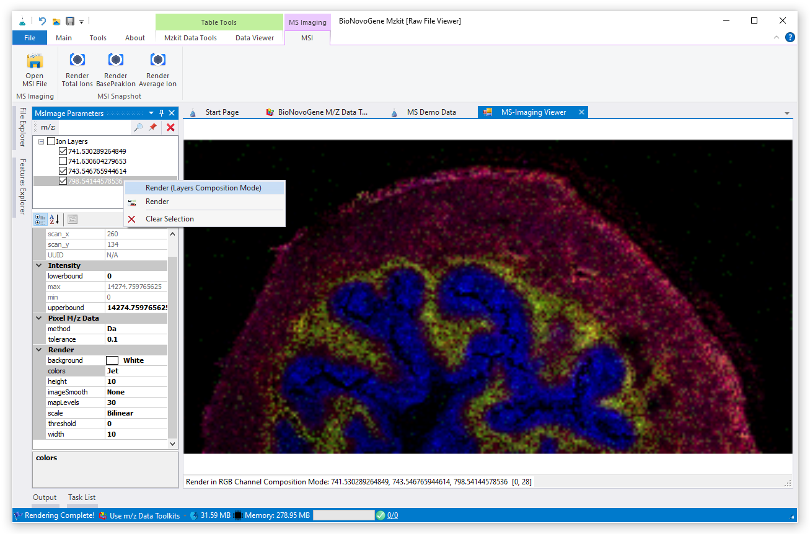
MSI Ion Rendering (RGB)
MSI ions rendering in RGB channels composition mode only supports 3 ion layers due to the reason of color is compose by RGB channels.
Ion Explorer
Select 3 ion at here.
Context menu on mouse right click for run image rendering.

Slide 52
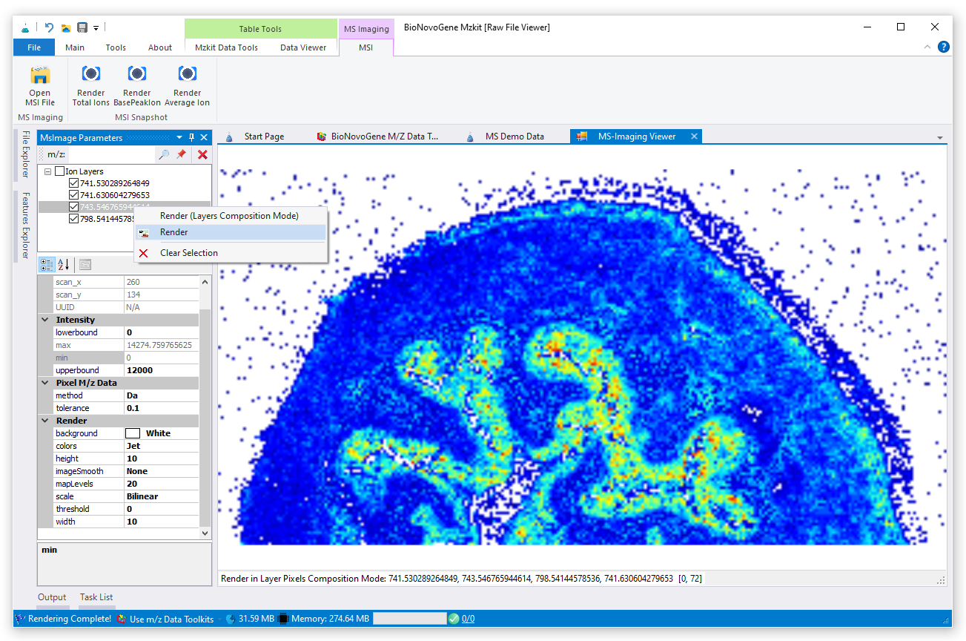
MSI Multiple Ion Rendering
Another mode for single/multiple ions MSI rendering in mzkit has no number limitation of the ions.
Ion Explorer
Select any ions at here.
Context menu on mouse right click for run image rendering.

Slide 53
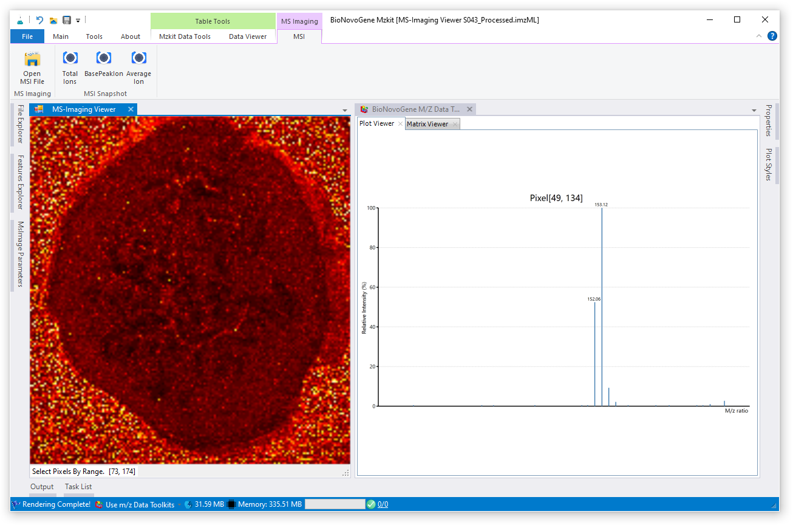
View Ion MS Content
Click on any pixel of the MSI rendering image for display the MS ions on target pixel scan
MSI Viewer
Click on the image for view MS ions on target pixel scan or select a region on image for view the total MS ion content on that region.

Slide 54
View GC-MS Targeted

Slide 55


View GC-MS Targeted
The GC-MS targeted data in CDF file format is supported in Mzkit.
View GC-MS targeted data in Mzkit includes view TIC data and SIM ions for metabolite quantification.
Steps for view GC-MS targeted data
in Mzkit:
[Main] Open
Select CDF format
View GC-MS data in Mzkit

Slide 56

View GC-MS Targeted
Feature Explorer
Select one ion at here for view mass spectrum plot data.
Select TIC node for view TIC plot of the current GC-MS experiment
MS Viewer
View the mass spectrum of the selected ion peak
Peak Explorer
View Ion peak on TIC at here, and select rt range with mouse drag.
View SIM Ions Of GC-MS Targeted

Slide 57

View GC-MS XIC
Feature Explorer
Select one ion at here for view its XIC plot.
View SIM Ions Of GC-MS Targeted

Slide 58
View LC-MS/MS Targeted

Slide 59



View LC-MS/MS Targeted
MRM stands for Multiple Reaction Monitoring.
In MRM, a specific ion (precursor ion) is selected in Q1 (first stage MS) from among various ions ionized by the ionization probe, the ion is destructed (collision-induced dissociation) in the collision cell (Q2, collision chamber), and a specific ion is detected from among the destructed ions (product ions) in Q3 (second stage MS).
Multiple channels can be set in one measurement.
Steps for view LC-MS/MS targeted data
in Mzkit:
[Main] Open
Select mzML format
View LC-MS/MS data in Mzkit

Slide 60

View LC-MS/MS Targeted
Content Viewer
View the mass spectrum of the selected ion peak
Feature Explorer
Select one ion pair at here for view extracted ion chromatography
plot data.
Select TIC node for view TIC plot of the current LC-MS/MS experiment
View LC-MS/MS Targeted MRM data in Mzkit

Slide 61

MRM TIC/BPC Overlaps
TIC Overlaps
View the TIC/BPC overlaps at here
Feature Explorer
Select multiple MRM raw data files for view TIC/BPC overlaps
TIC/BPC
Show TIC/BPC overlaps via context menu
View LC-MS/MS Targeted MRM data in Mzkit

Slide 62
Targeted quantification analysis

Slide 63



Create Linear Models
Targeted linear analysis tools in mzkit supports LC-MSMS(MRM) and GC-MS(SIM) data analysis.
Steps for create linear model in mzkit:
imports reference linear raw data files
edit reference contents for each level
setup IS relationship
[Tools] Targeted Quantification
Imports Linear Reference
Edit content levels and IS relationships

Slide 64

Create Linear Models
Linear Viewer
view linear modelling result
Linear Modeller
Edit linear content levels and IS relationship with the target metabolites

Slide 65



感谢观看
Thank you for your attention
苏州帕诺米克生物医药科技有限公司
地址：江苏省苏州市工业园区新平街388号22幢2层
电话：0512-62959105
邮箱：info@bionovogene.com
网址：https://www.bionovogene.com www.biodeep.cn
科研服务订阅号
科研服务公众号
健康服务公众号

